Slide 1
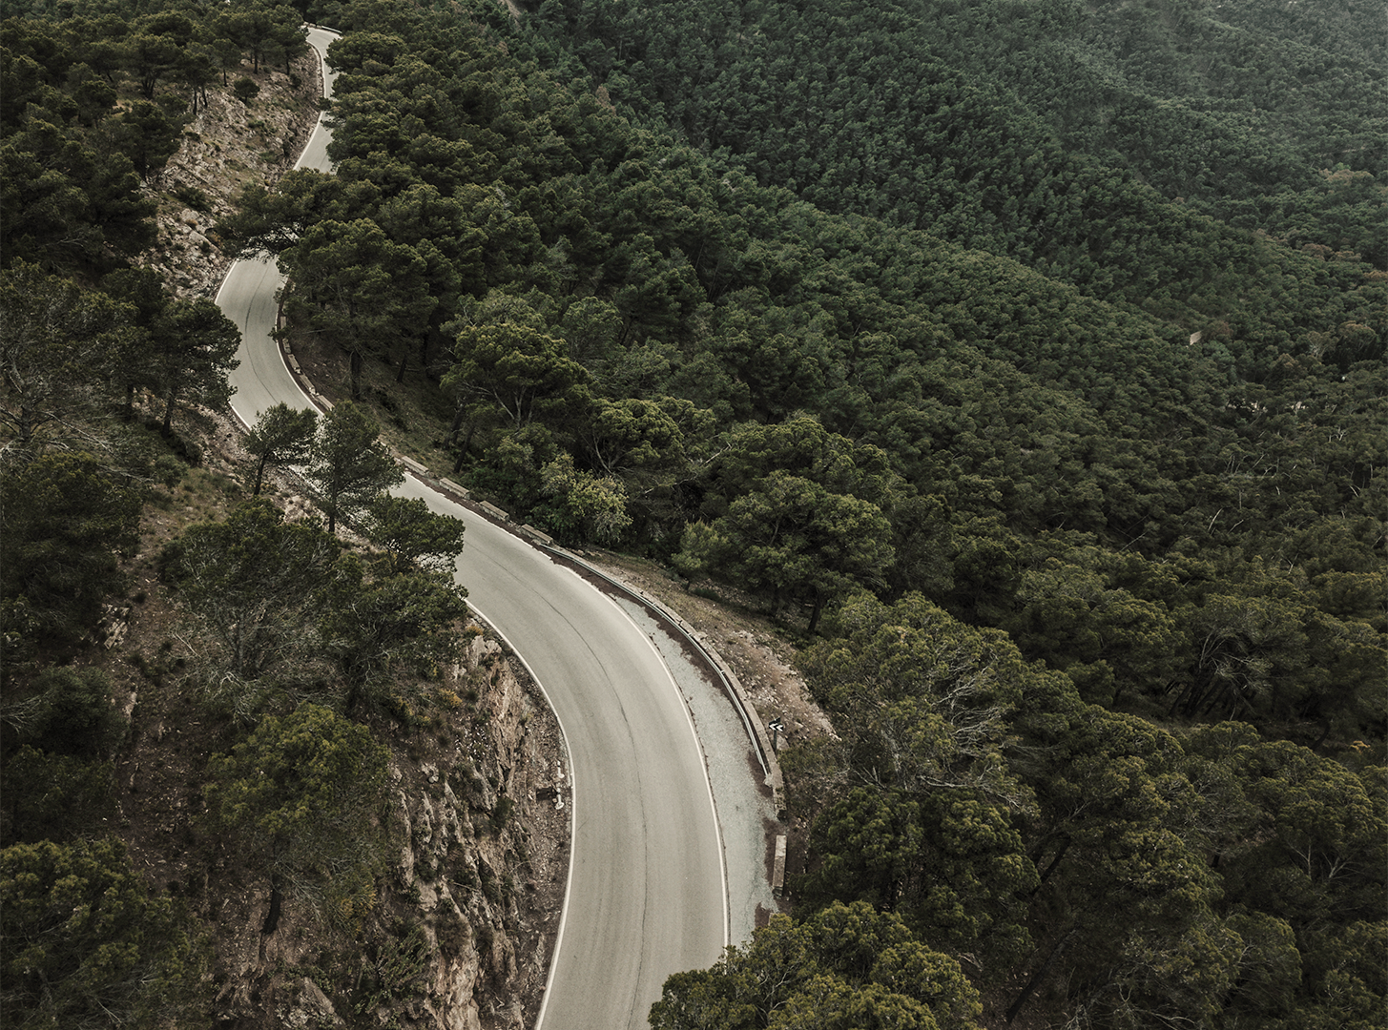
ENGINEERING
PROJECT
PROPOSAL
Here is where your presentation begins

Slide 2
ABOUT THE PROJECT
01
MAJOR REQUIREMENTS
02
TABLE OF CONTENTS
PROJECT GOALS
03
SNEAK PEEK
04
PROJECT STAGES
05
Here you could describe the topic of the section
Here you could describe the topic of the section
Here you could describe the topic of the section
Here you could describe the topic of the section
Here you could describe the topic of the section

Slide 3
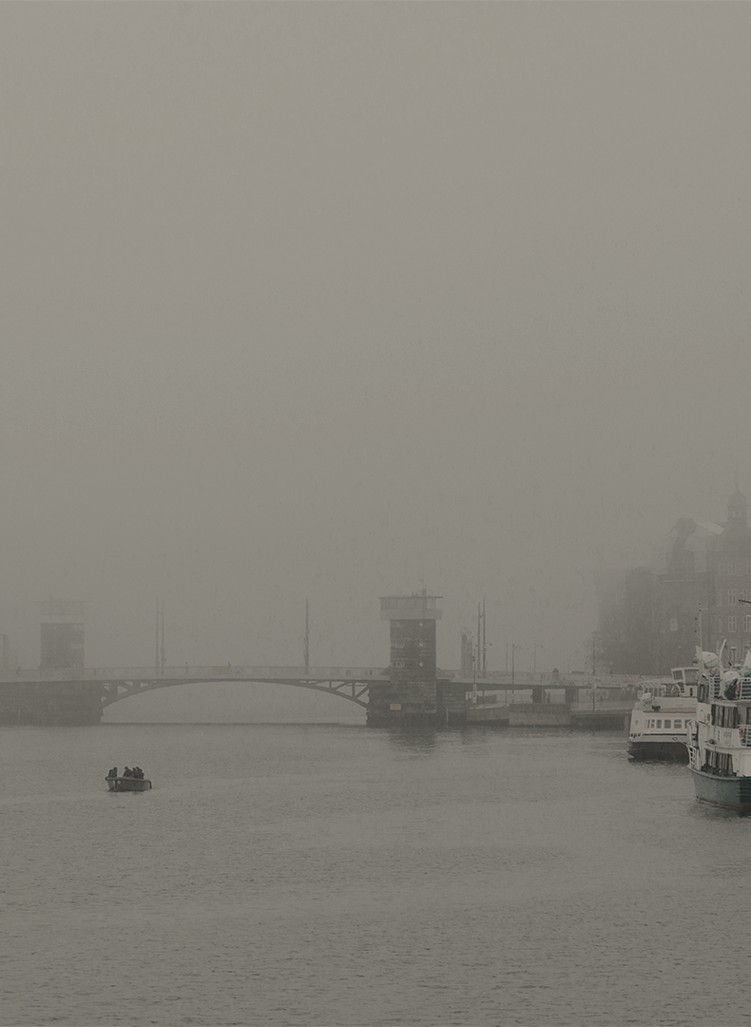
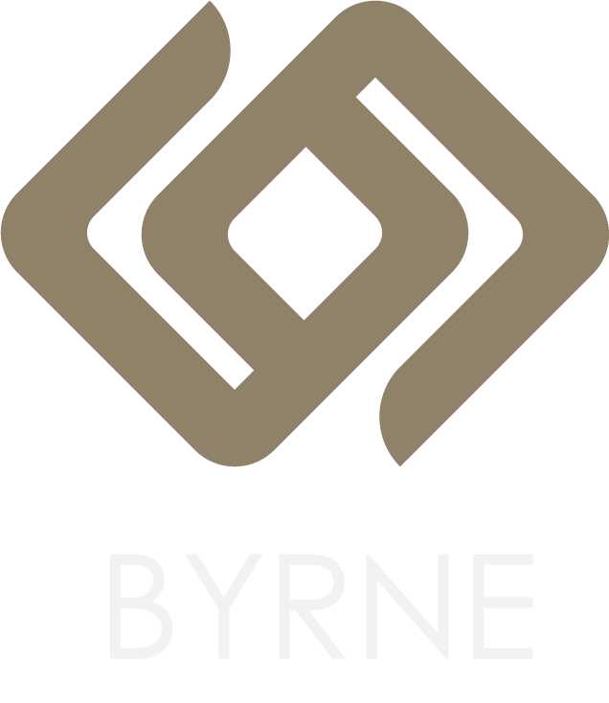
OUR COMPANY
Mercury is the closest planet to the Sun and the smallest one in the Solar System—it’s only a bit larger than our Moon. The planet’s name has nothing to do with the liquid metal since it was named after the Roman messenger god, Mercury

Slide 4
ROAD BRIDGES
INDUSTRIAL BUILDINGS
WHAT WE ARE WORKING ON
SUBWAY STATIONS
THERMAL
POWER STATIONS
Despite being red, Mars is a cold place, not hot. It’s full of iron oxide dust, which gives the planet its reddish cast
Jupiter is a gas giant and the biggest planet in our Solar System. It’s the fourth-brightest object in the sky
Yes, Saturn is the ringed one. This planet is a gas giant, and it’s composed mostly of hydrogen and helium
Venus has a beautiful name and is the second planet from the Sun. It’s terribly hot, even hotter than Mercury

Slide 5
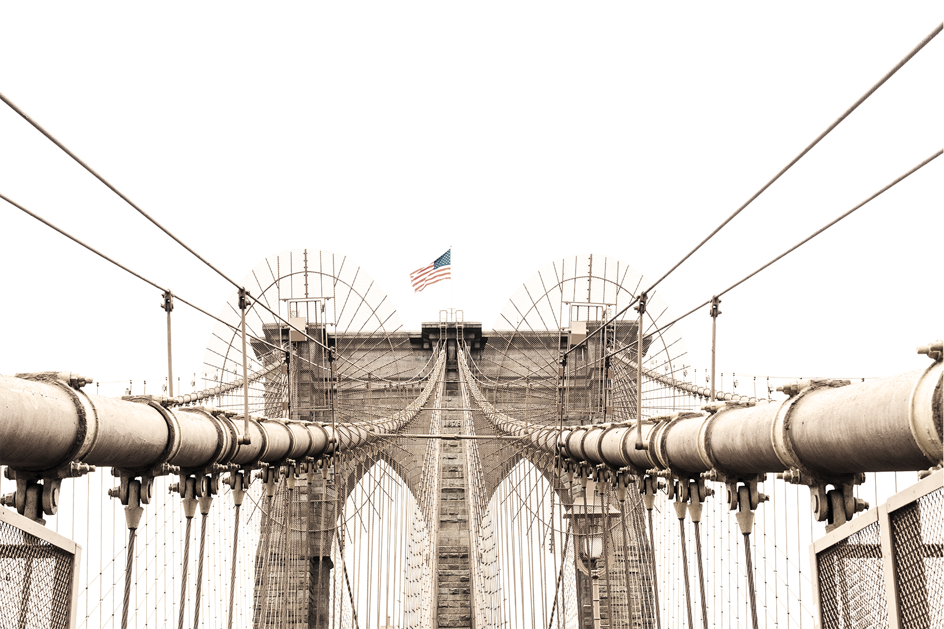
WHAT WE ARE WORKING ON
GAS PIPELINES
TUNNEL WORKS
WATER TREATMENT PLANTS
Yes, Saturn is the ringed one. This planet is a gas giant, and it’s composed mostly of hydrogen and helium
Jupiter is a gas giant and the biggest planet in our Solar System. It’s the fourth-brightest object in the sky
Despite being red, Mars is a cold place, not hot. It’s full of iron oxide dust, which gives the planet its reddish cast

Slide 6
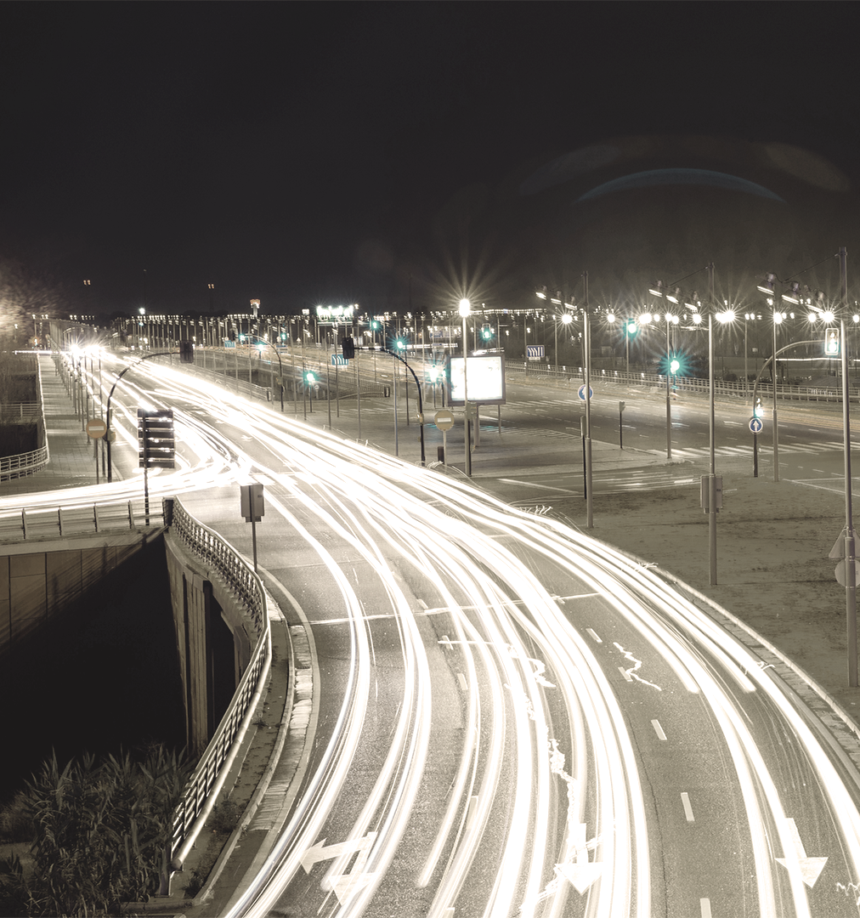
ABOUT THE PROJECT
Mercury is the closest planet to the Sun and the smallest one in the Solar System—it’s only a bit larger than our Moon. The planet’s name has nothing to do with the liquid metal since it was named after the Roman messenger god, Mercury

Slide 7
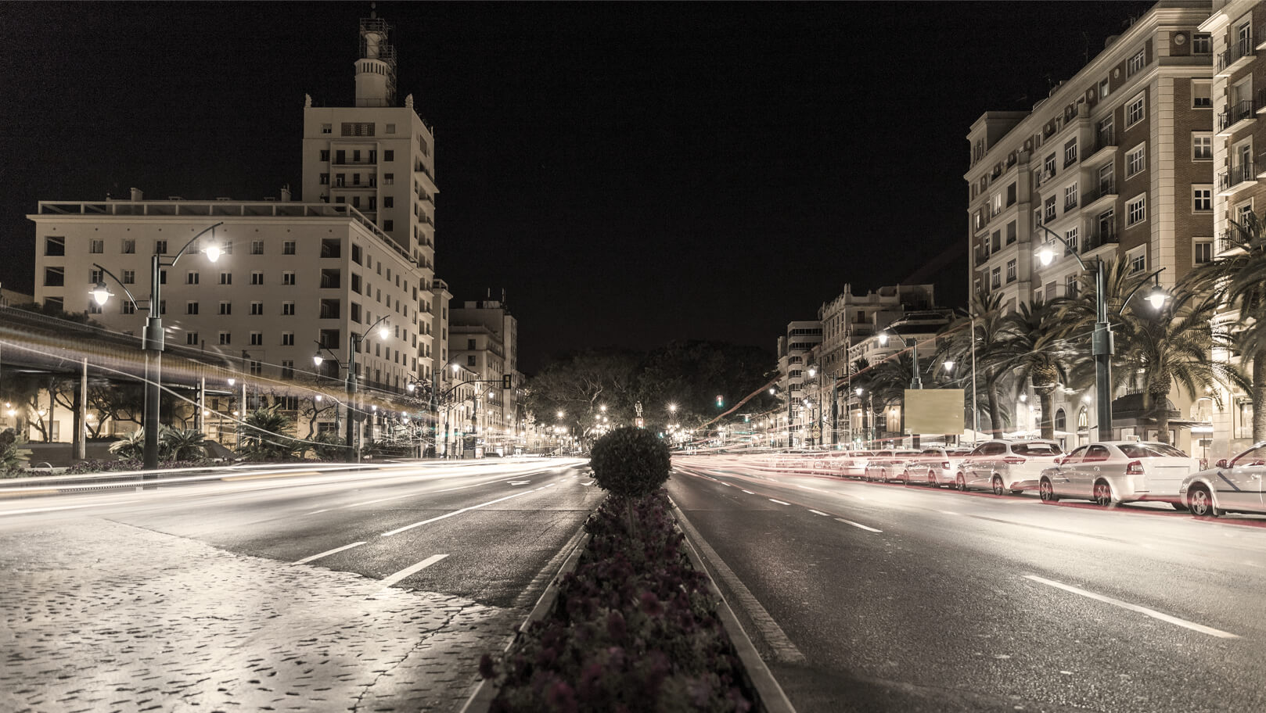
“Here comes the quote. Words full of wisdom that someone important said and can make the reader get inspired.”
—SOMEONE FAMOUS

Slide 8
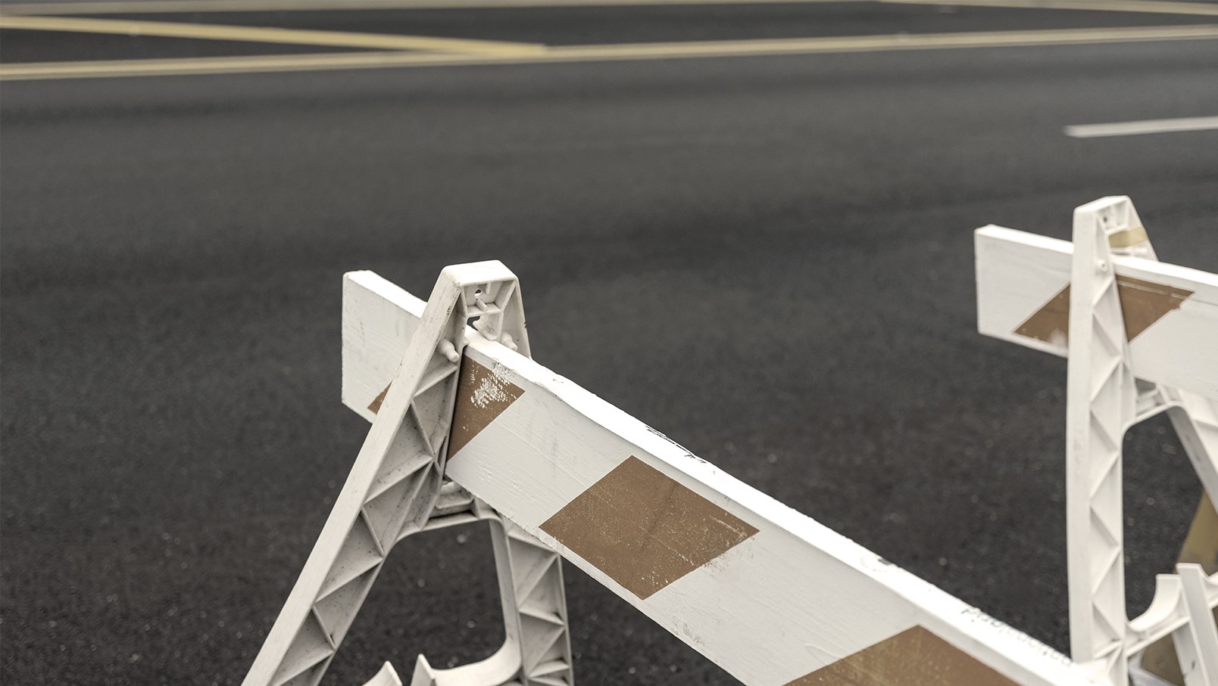
NOW
Mercury is the closest planet to the Sun and the smallest one in our Solar System—it’s only a bit larger than our Moon. The planet’s name has nothing to do with the liquid metal, since it was named after the Roman messenger god

Slide 9
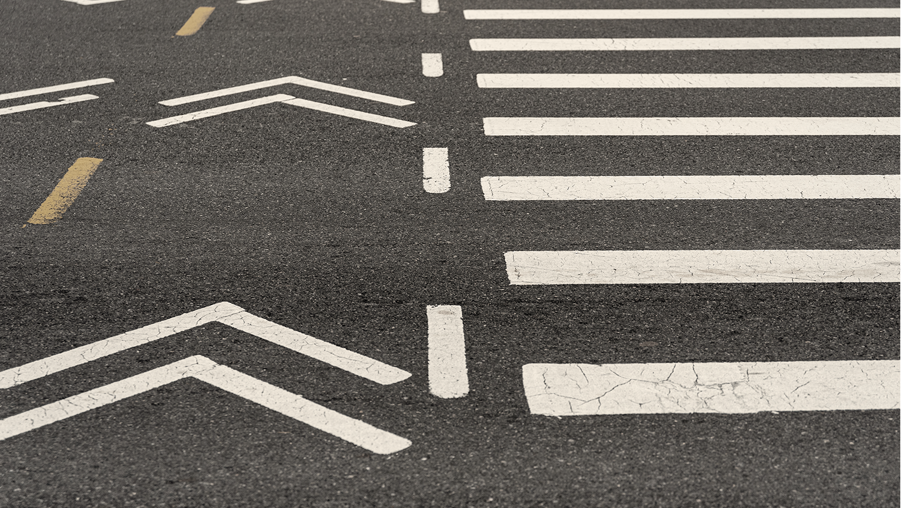
FUTURE
Venus has a beautiful name and is the second planet from the Sun. It’s terribly hot—even hotter than Mercury—and its atmosphere is extremely poisonous. It’s the second-brightest natural object in the night sky after the Moon

Slide 10
MARS
JUPITER
SATURN
MAJOR REQUIREMENTS
NEPTUNE
VENUS
VENUS
Despite being red, Mars is a cold place, not hot. It’s full of iron oxide dust
It’s a gas giant, the biggest planet in our Solar System and the fourth-brightest object in the sky
Yes, this is the ringed one. It’s a gas giant, composed of hydrogen and helium
Neptune is the fourth-largest planet in our Solar System and the farthest from the Sun
Venus has a beautiful name and is the second planet from the Sun. It’s terribly hot
Venus has a beautiful name and is the second planet from the Sun. It’s terribly hot

Slide 11
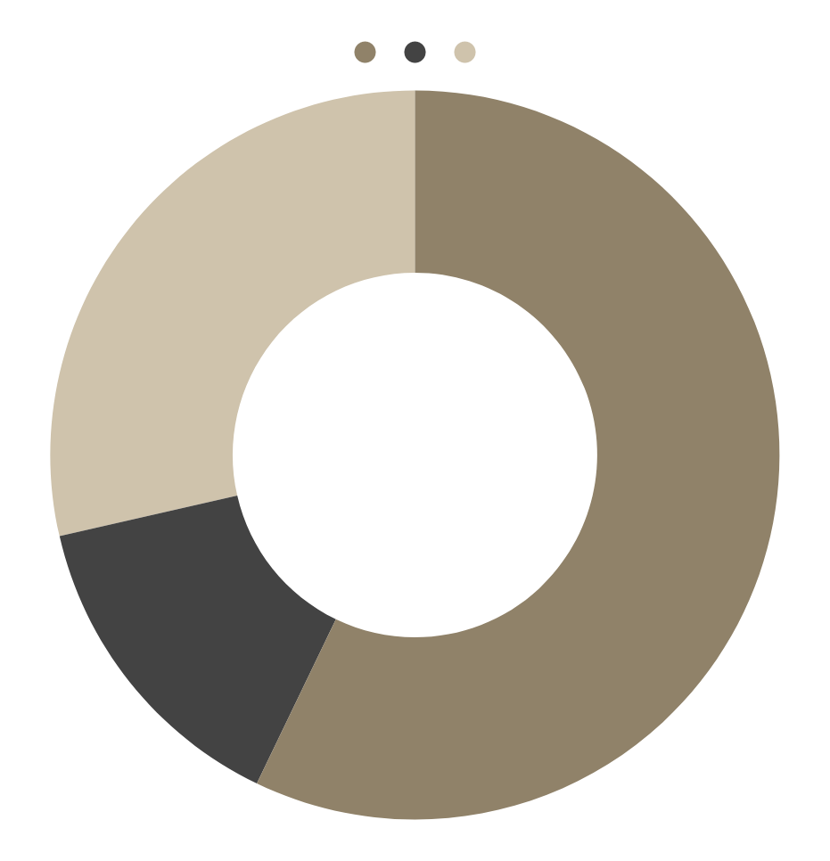
VENUS
30%
BUDGET
MARS
60%
MERCURY
10%
If you want to modify this graph, click on it, follow the link, change the data and replace it

Slide 12
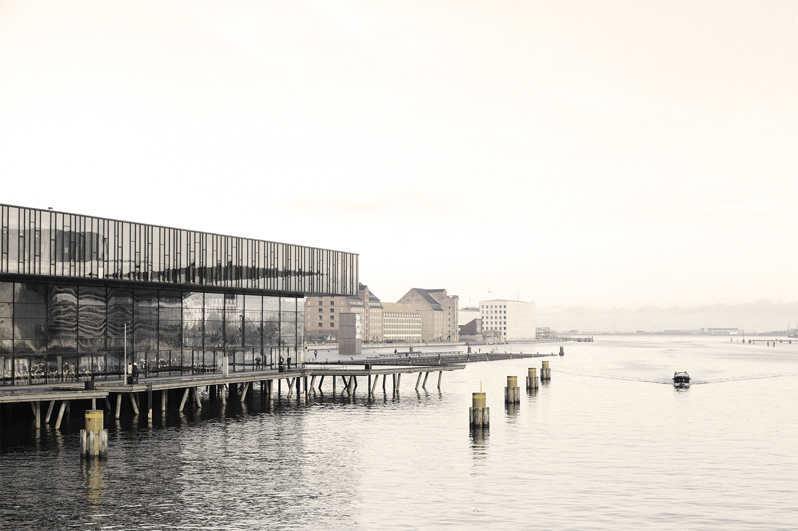
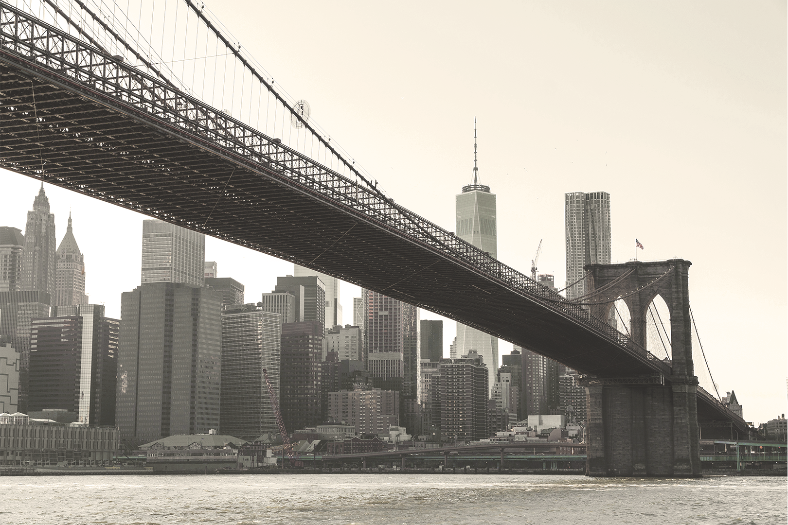
PROJECT GOALS
GOAL 1
GOAL 2
Mercury is the closest planet to the Sun and the smallest one in the Solar System—it’s only a bit larger than our Moon
Venus has a beautiful name and is the second planet from the Sun. It’s terribly hot, even hotter than Mercury

Slide 13

SNEAK PEEK
Mercury is the closest planet to the Sun and the smallest one in the Solar System—it’s only a bit larger than our Moon. The planet’s name has nothing to do with the liquid metal, since it was named after the Roman messenger god, Mercury

Slide 14
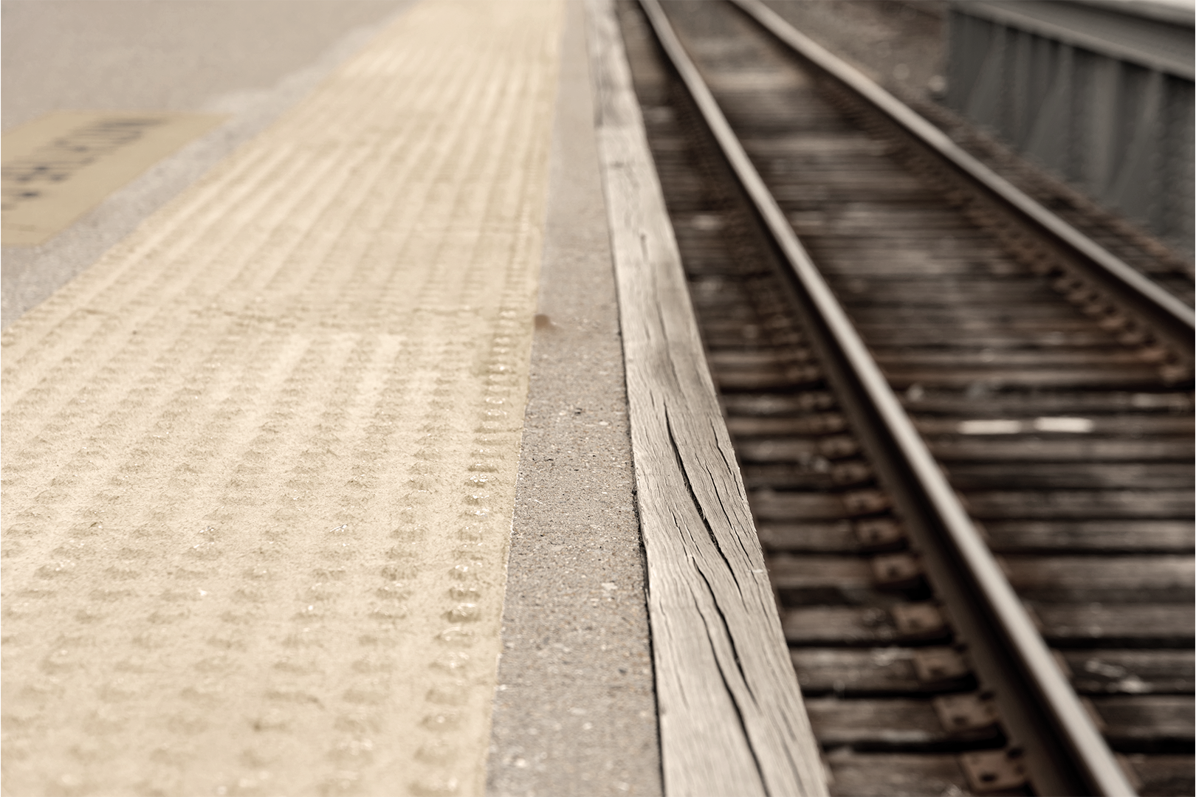
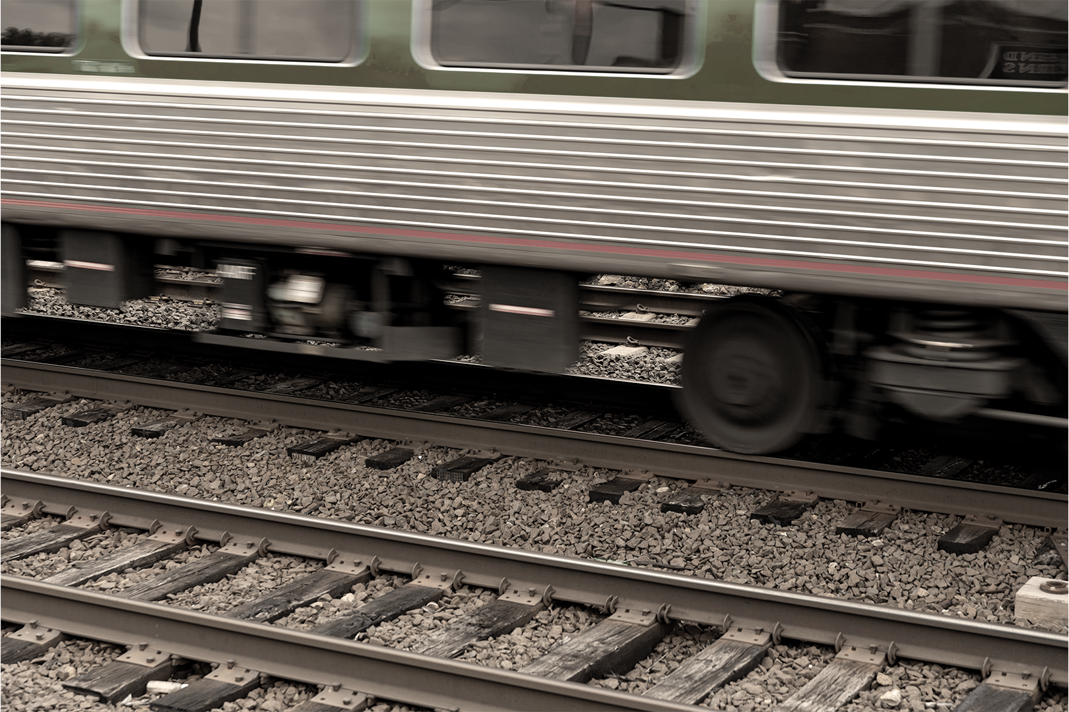
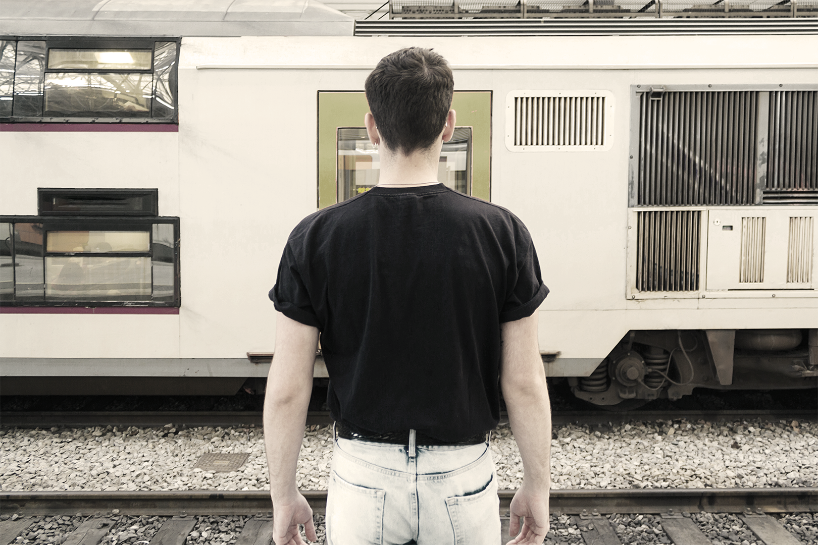
STAGE 1
PROJECT STAGES
STAGE 2
STAGE 3
Venus has a beautiful name and is the second planet from the Sun. It’s terribly hot
Mercury is the closest planet to the Sun and the smallest one in the Solar System
Despite being red, Mars is a cold place, not hot. It’s full of iron oxide dust, giving the planet its reddish cast

Slide 15
MERCURY
MARS
FUTURE PROJECTS
VENUS
SATURN
Mercury is the closest planet to the Sun and the smallest one in the Solar System
Despite being red, Mars is a cold place, not hot. It’s full of iron oxide dust
Venus has a beautiful name and is the second planet from the Sun
Saturn is the ringed planet. It’s a gas giant, composed mostly of hydrogen and helium

Slide 16
TIMELINE
DAY 2
DAY 4
Venus has a beautiful name, but it’s terribly hot
Saturn is composed of hydrogen and helium
DAY 1
DAY 3
DAY 5
Mercury is the closest planet to the Sun
Despite being red, Mars is a cold place, not hot
Neptune is the farthest planet from the Sun

Slide 17
OUR LOCATIONS
Mercury is the closest planet to the Sun and the smallest one in the Solar System

Slide 18
OUR PARTNERS
MERCURY
VENUS
Mercury is the closest planet to the Sun and the smallest one in our Solar System—it’s only a bit larger than our Moon. The planet’s name has nothing to do with the liquid metal, since it was named after the Roman messenger god
Venus has a beautiful name and is the second planet from the Sun. It’s terribly hot—even hotter than Mercury—and its atmosphere is extremely poisonous. It’s the second-brightest natural object in the night sky

Slide 19


OUR TEAM
You can replace the image on the screen with your own
You can replace the image on the screen with your own

Slide 20
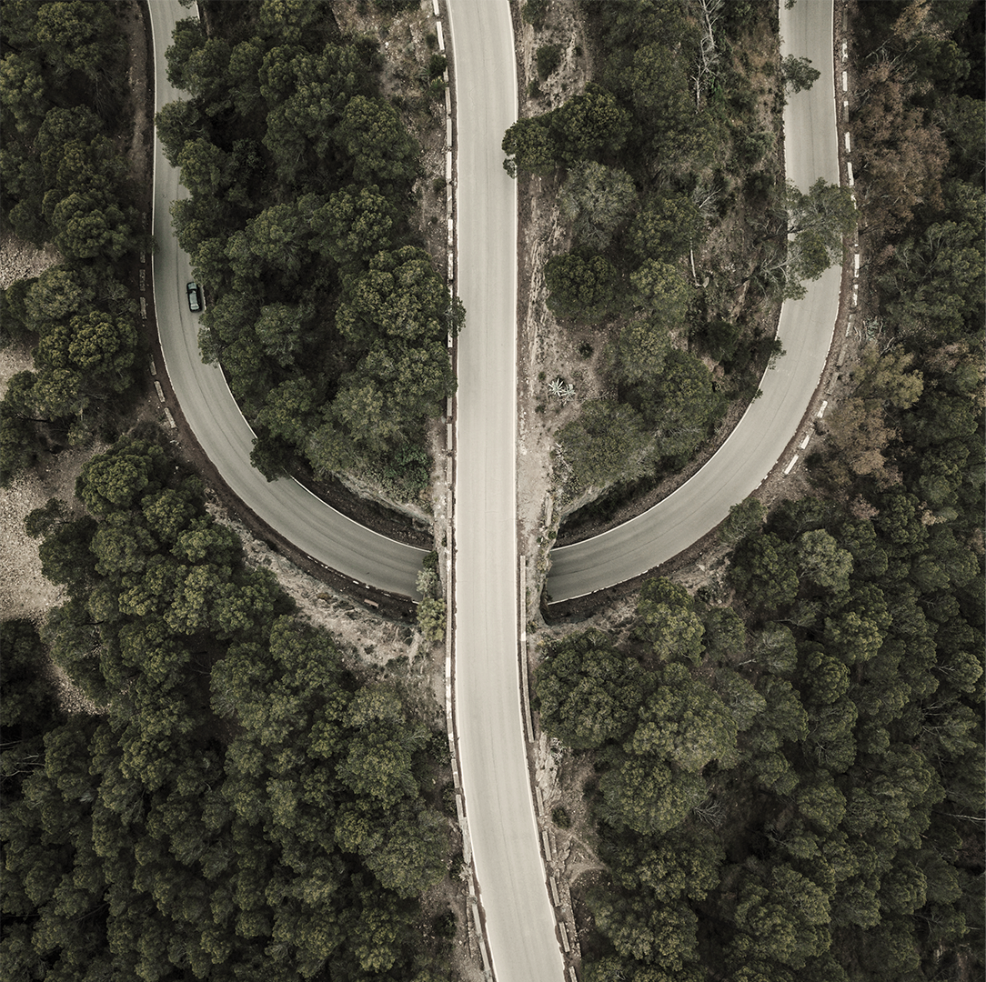
THANKS
Does anyone have any questions?
Follow the project updates
addyouremail@freepik.com
+91 620 421 838
yourcompany.com

